Slide 1
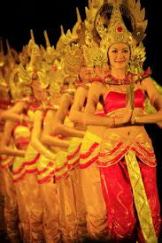
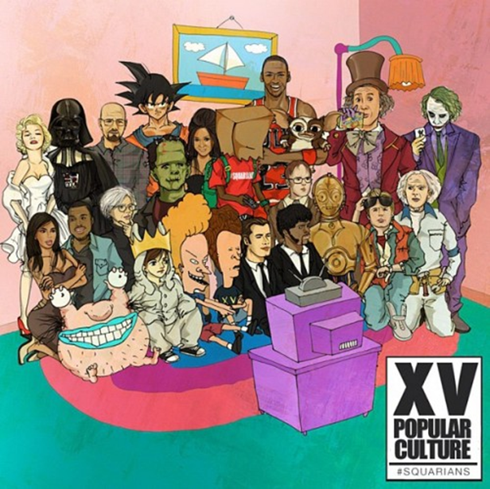
Folk and Popular Culture

Slide 2
Origin of Culture
Folk Culture
Popular Culture
Isolated, clustered
Topics involve every day life, environment, beliefs
Passed down orally
Traditions
Spread by relocation diffusion
Little change over time
Separate, multiple hearths
Worldwide, dispersed
Hierarchical diffusion then contagious diffusion
Spread to make money
Entertainment
Current traditions and fads
Constantly changing
Not impacted by environment

Slide 3
Origin of Music
Folk
Anonymous hearths, transmitted orally
About everyday life, things that are familiar to group
Country music hearts-Upper south
Vietnamese Song
Popular
Made to be sold worldwide
Tin Pan Alley developed in NY
Hip hop is a good example of pop culture with local culture infused

Slide 4
Diffusion Examples
Amish
Distinctive clothing, farming, religion still around today
70,000, 17 states
Migrated from Switzerland, France and Germany because of low land prices
Diffused by relocation
Isolated from other Amish communities but still very similar
Soccer
11th century in England, spread outward because of increased leisure time
Each country has preferred sports (Cricket, Hockey, Martial Arts and Lacrosse)
T.V. and internet allow global spectators
Hierarchical diffusion
World Cup

Slide 5
Clustering of Folk Cultures
Isolation promotes cultural diversity
Himalayan art styles that show differences among geographically close culture groups
Tibet, Nepal, Hindus and Animist art styles
Influence of the physical environment on food
People hold on to old food habits after assimilating
People adapt their food preferences based on environment
Soybeans, quick frying and stewing/roasting
Certain foods are avoided or desired
Bulls, mandrake, otters, potatoes, or goats
Transylvanian food diversity
Romanians, Jews, Armenians and Hungarians

Slide 6
Himalayan Folk Cultural Regions
Fig. 4-5: Cultural geographers have identified four distinct culture regions based on predominant religions in the Himalaya Mountains.

Slide 7
Folk Housing is a product of both cultural traditions and environmental conditions
Houses are made from nearby materials and influenced by social factors
Environment influences floor plans based on climate
Social conditions affect the floor plan of houses
Fiji, China, Middle East, India, Africa, Madagascar, Java
U.S. Folk House Forms
Colonists brought their architecture style with them
3 hearths-New England, Mid Atlantic, Lower Chesapeake
New England-Saltbox, Two-Chimney, Cape Cod and Front Gable & wing
Middle Atlantic- “I” house
Lower Chesapeake- steep roof and chimneys

Slide 8
House Types in Western China

Slide 9
Diffusion of New England House Types
Fig. 4-10: Four main New England house types of the eighteenth and nineteenth centuries diffused westward as settlers migrated.

Slide 10
U.S. House Types by Region
Fig. 4-1-1: Small towns in different regions of the eastern U.S. have different combinations of five main house types.

Slide 11
Popular Culture Housing and Clothing
Environment still has an influence on clothing, housing and food styles
Housing styles follow current architectural fashions
Fashion is the best example of Hierarchical diffusion
Japanese wearing jeans
Reflect wealth and occupation
Hearths are Paris, Milan, London and New York
Some folk culture styles appear on runways (poncho)

Slide 12
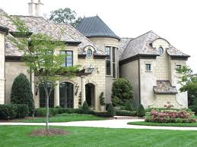
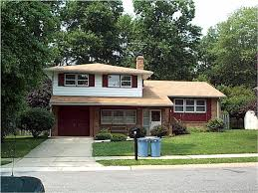

Slide 13
Popular Culture Food
High consumption of alcohol and snacks show the level of development
Alcohol consumption is very regionalized
Bourbon, rum, whiskey, vodka
Religious regions have lower consumption rates
Snacks are regional too
Tortillas near Mexico, Multigrain chips in CA
Wine production
Located in temperate climates…regional

Slide 14
Role of TV, Internet and Radio
Popular culture has spread much faster in recent years because of new technology
Think Gangham Style from South Korea
1st TVs in 1930s
More TVs per person shows level of development
Internet allows for almost instant diffusion
Twitter, Facebook, YouTube
Governments censor TV and internet
Form of control
Fall of USSR
Western clothing and women status for Taliban

Slide 15
Threats to Folk Culture
As popular culture spreads faster and faster, it threatens to overtake folk culture
Threatens the subservient role of women
Taliban
Threatens government control of media
USA, UK and Japan are the dominate new sources
83% of Uganda’s new is foreign made
This means the political views and culture will be diffused into these LDC countries
Called Media Imperialism

Slide 16
Popular Culture threats to the Environment
Popular culture modifies the environment
Theme parks, golf courses,
Creates a uniform landscape
Every city looks the same
Increased demand for natural resources
More urban development means more resources to build
Increased Pollution
More waste

