Slide 1
Language
Chapter 5

Slide 2
Origin, Diffusion & Dialects of English
Origin/Diffusion
Dialects of English
  English colonies
  Origin of English in England
  Dialects in England
  Differences between British and American English
  Dialects in the United States

Slide 3
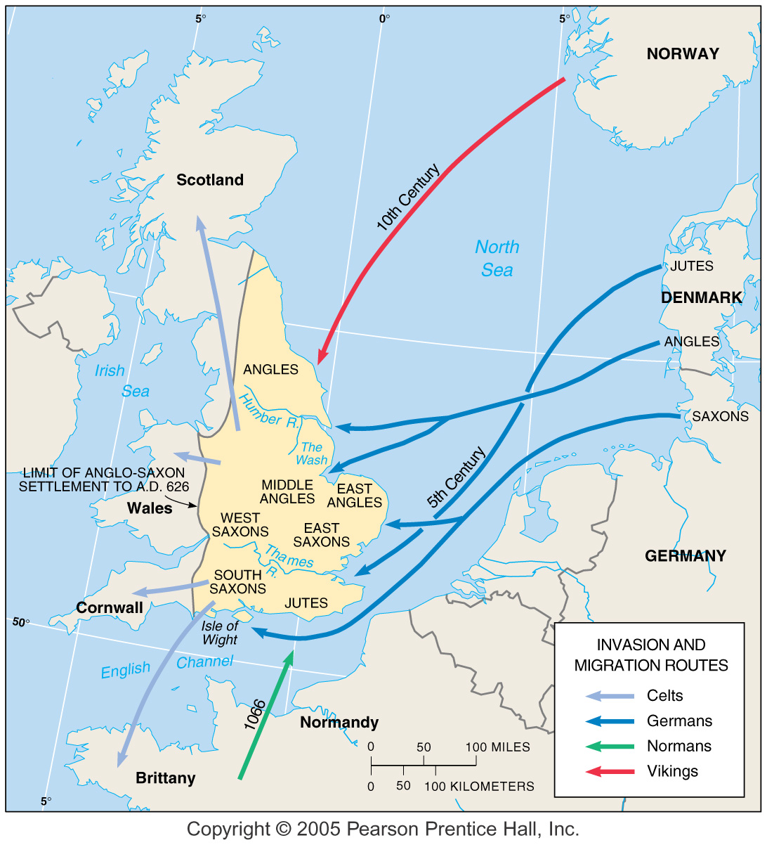
Invasions of England
5th–11th centuries
Fig. 5-2: The groups that brought what became English to England included Jutes, Angles, Saxons, and Vikings. The Normans later brought French vocabulary to English.

Slide 4
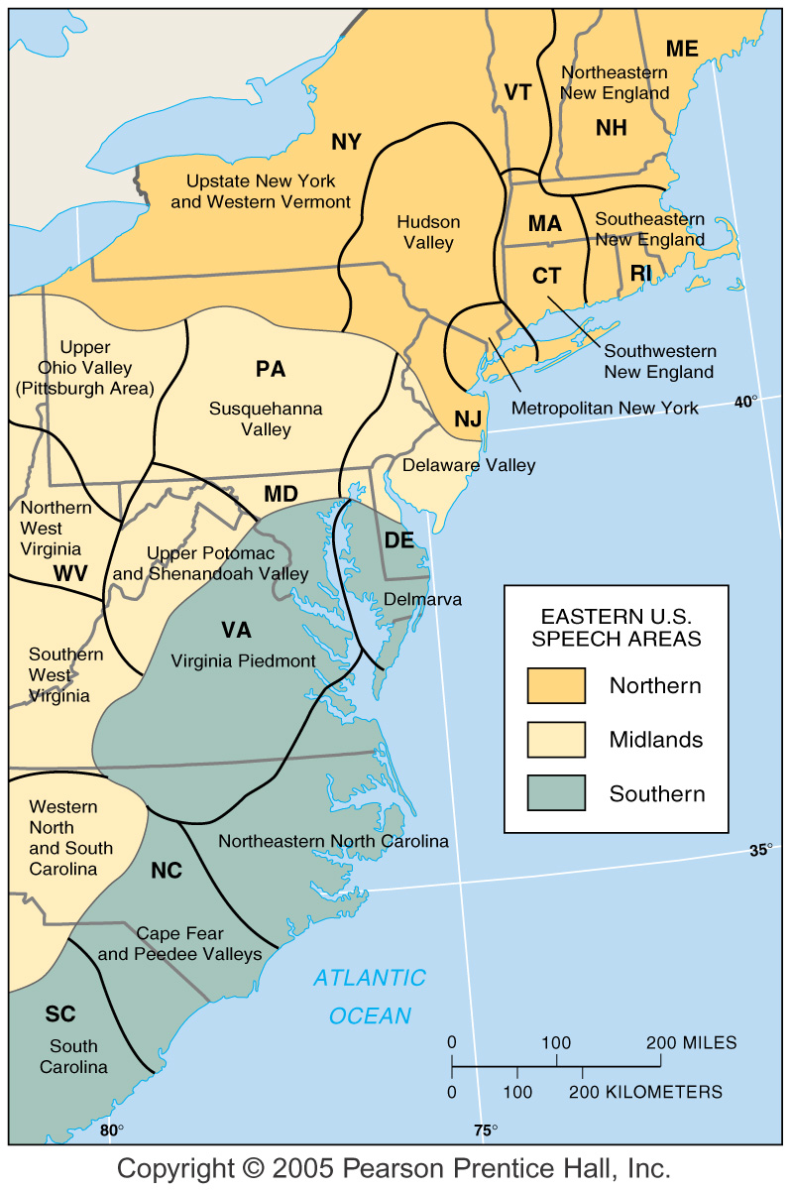
Dialects in the Eastern U.S.
Fig. 5-4: Hans Kurath divided the eastern U.S. into three dialect regions, whose distribution is similar to that of house types (Fig. 4-9).

Slide 5
The Indo-European Language Family
Branches of Indo-European
  Germanic branch
  Indo-Iranian branch
  Balto-Slavic branch
  Romance branch
Origin and diffusion of Indo-European
  Kurgan (Maria Gimbutas) and Anatolian theories (Colin Renfrew)

Slide 6
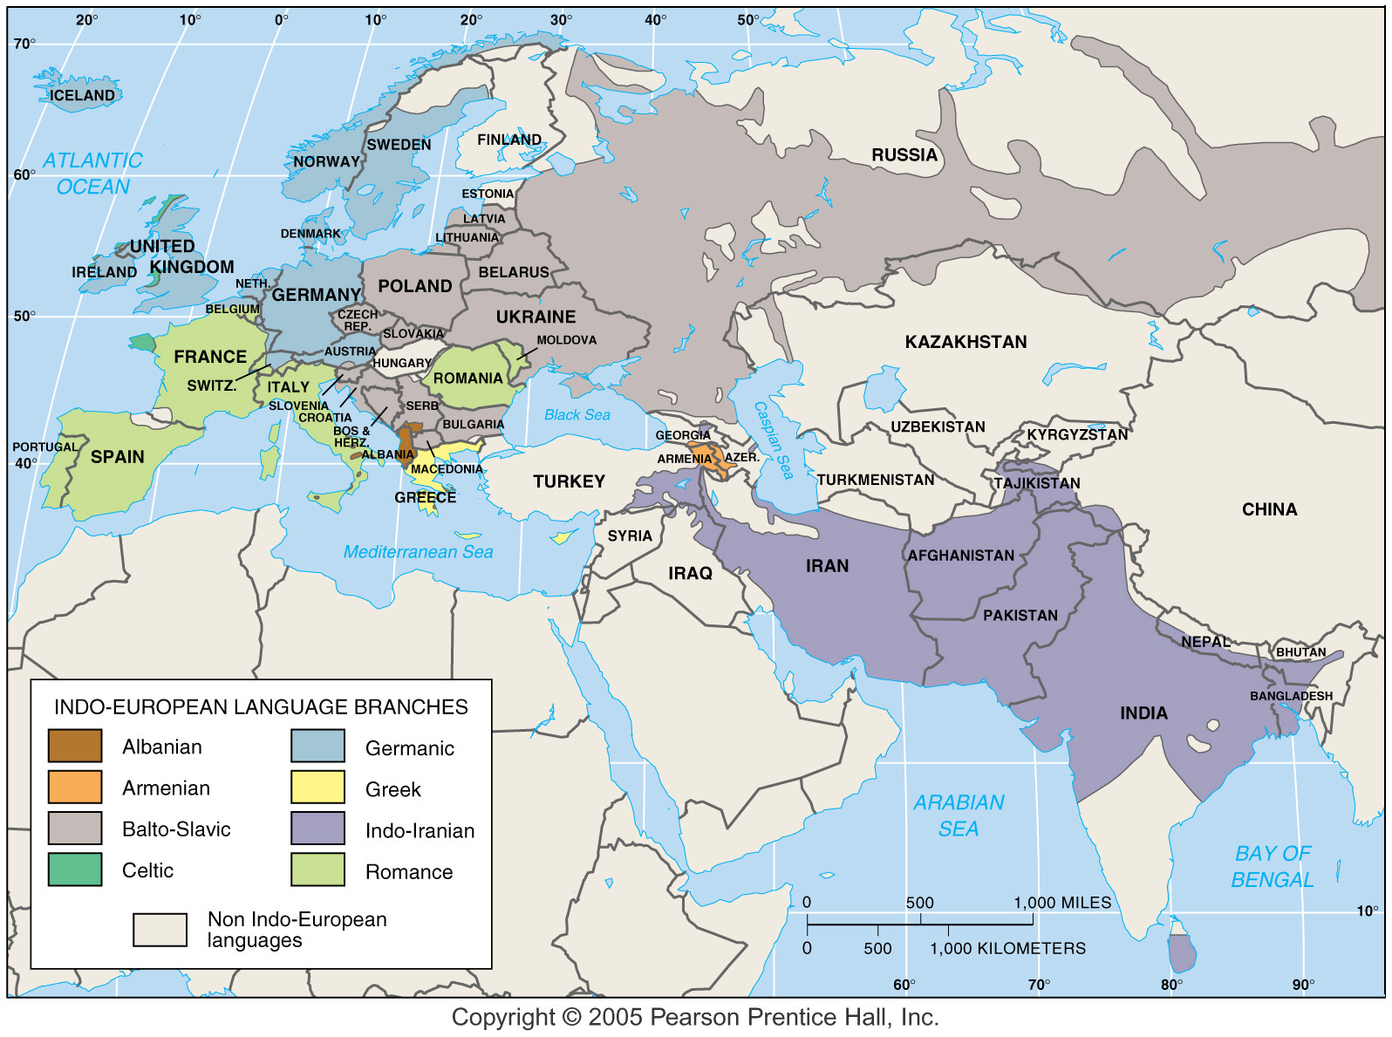
Indo-European Language Family

Slide 7
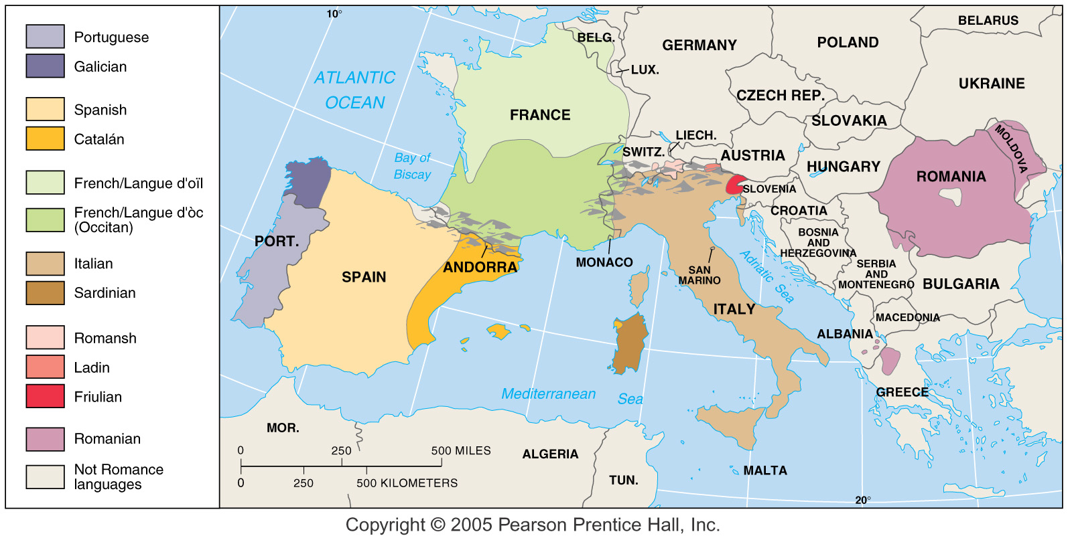
Romance Branch of Indo-European
Fig. 5-8: The Romance branch includes three of the world’s 12 most widely spoken languages (Spanish, French, and Portuguese), as well as a number of smaller languages and dialects.

Slide 8
Family>Branch>Group
Language Family | 18 language Families Afro-Asiatic, Altaic, Amerindian, Austrailian, Austro-Asiatic, Austronesian, Causasian, Dravidian, Eskimo-Aleut, Indo European, Japanese, Khoisan, Niger-Congo, Nilo-Saharan, Papuan, Sino-Tibetan, Uralic, Sparsely populated
Language Branch | Derived from common language family
Language Group | Collection of languages within a language branch
Example: English
Indo-European (Family)>Germanic (Branch)>West Germanic (Group)

Slide 9
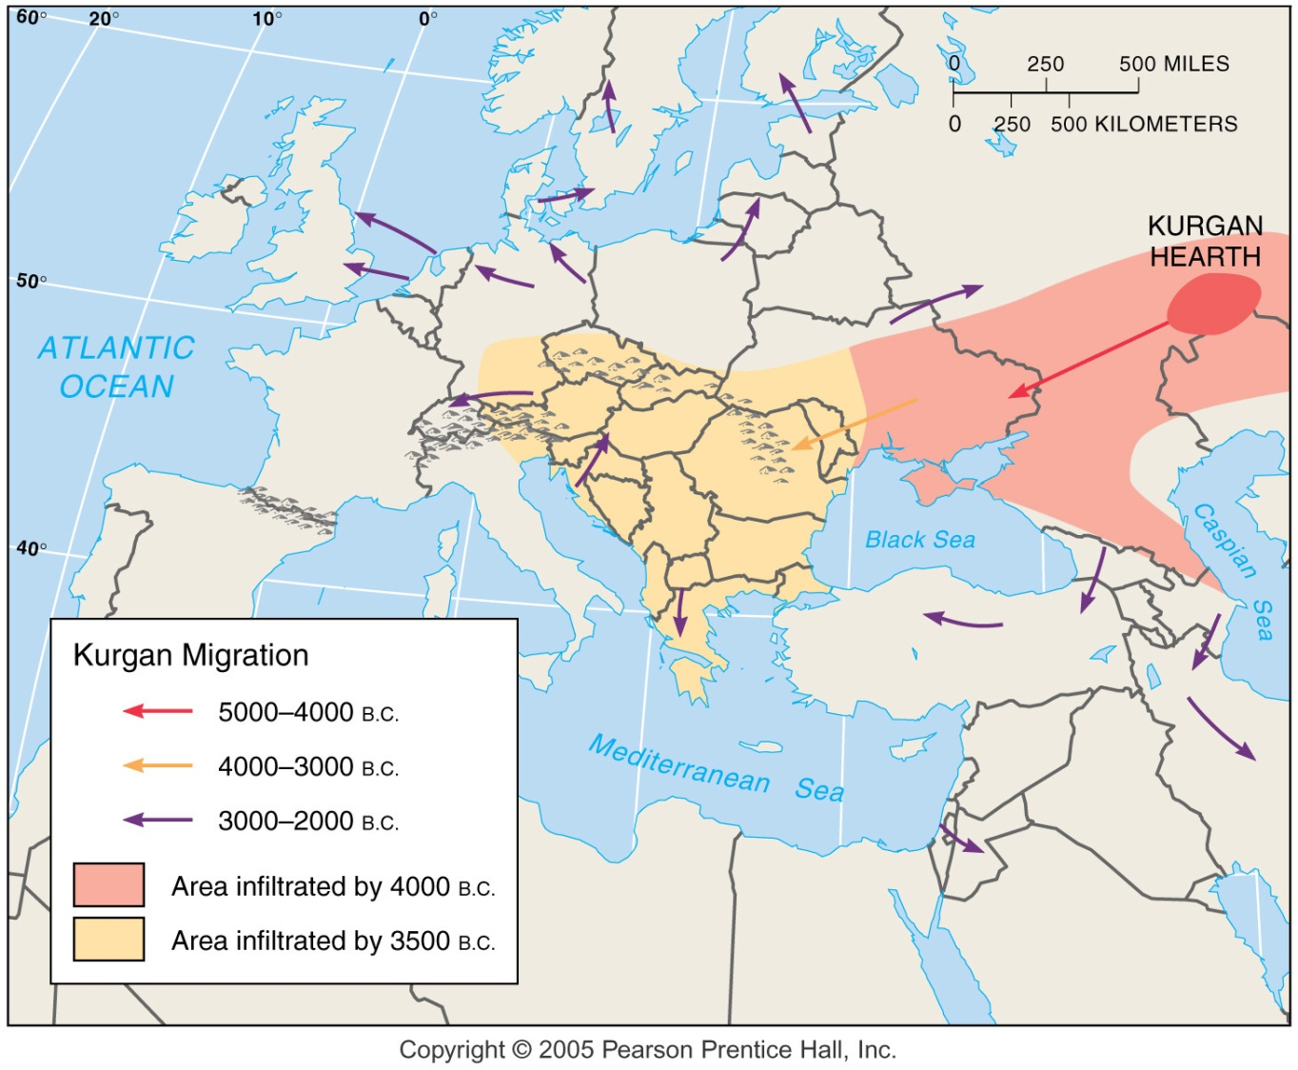
Kurgan Theory of Indo-European Origin
Fig. 5-9: In the Kurgan theory, Proto-Indo-European diffused from the Kurgan hearth north of the Caspian Sea, beginning about 7,000 years ago.

Slide 10
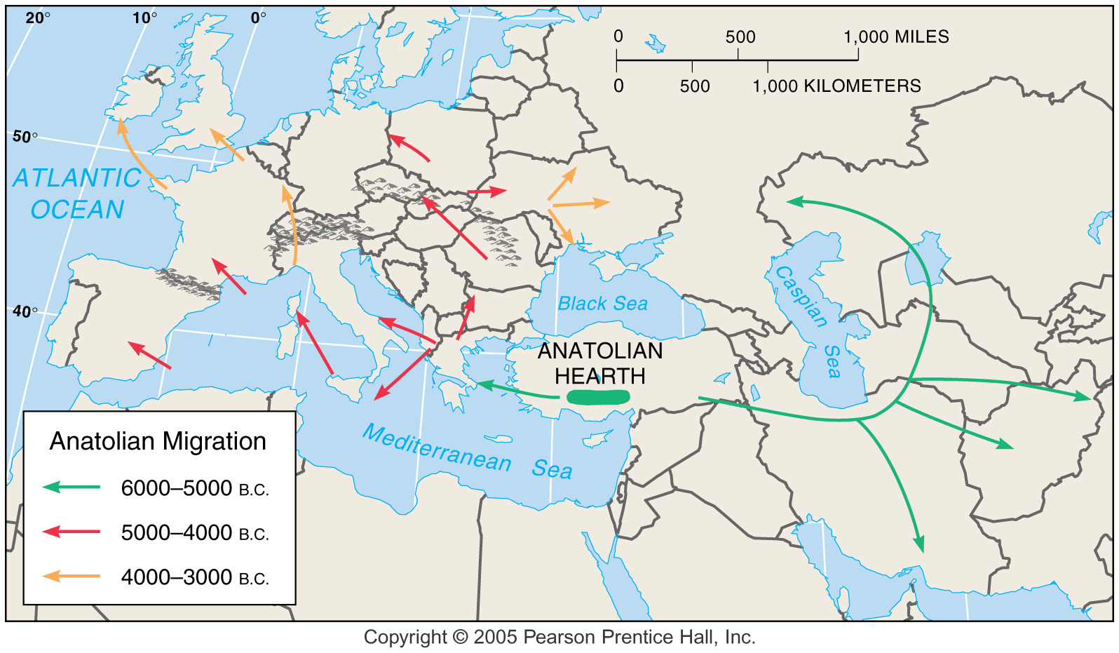
Anatolian Hearth Theory of Indo-European Origin
Fig. 5-10: In the Anatolian hearth theory, Indo-European originated in Turkey before the Kurgans and diffused through agricultural expansion.

Slide 11
Distribution of Other Language Families
Classification of languages
Distribution of language families
  Sino-Tibetan language family
  Other East and Southeast Asian language families
  Afro-Asiatic language family
  Altaic and Uralic language families
  African language families

Slide 12
Extinct Languages
Gothic
  Many switched to speaking Latin as they converted to Christianity
Hebrew
  Extinct but revived in 1948 when Israel made it an official language
  Eliezer Ben-Yehuda is credited for creating 4,000 new Hebrew words
Celtic
  Was the original language of England; rarely spoken
  1988 education act made Welsh language training mandatory

Slide 13
Celtic Groups
Goidelic
Irish Gaelic
Scottish Gaelic
Brythonic
Welsh
Cornish
Breton

Slide 14
Multilingual States
Isolated Languages
Belgium
  French (walloons) Flemish (Flemings)
  Divided Belgium into Flanders/Wallonia
Switzerland
  Peaceful existance of 4 languages
Quebec
  Québécois/immigrants
Basque
  No connection to any language family
  Geographical isolated preserved language
Icelandic
  Changed less that any other Germanic branch because of isolation

Slide 15
Global Dominance of English
Lingua Franca
  Pidgin language
  English, Swahili, Hindustani, Russia
Modern Expansion Diffusion
  Migration/conquest changed to expansion diffusion
  Ebonics
Mixing languages
  Franglais
  Spanglais

